Slide 1
Maxwell’s Demon for the Split Problem
[Y. An, 2023]
2023
Speaker: Yang An
Zhejiang University of Technology

Slide 2
Outline

Slide 3
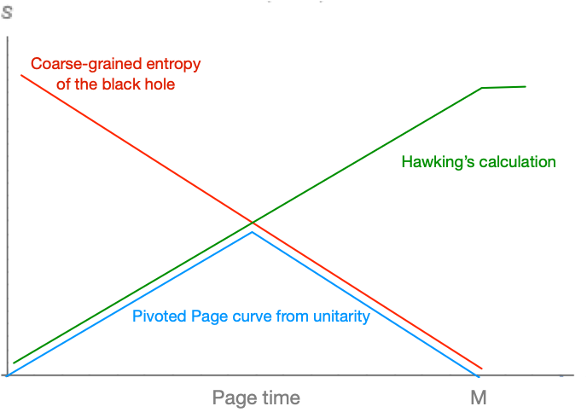
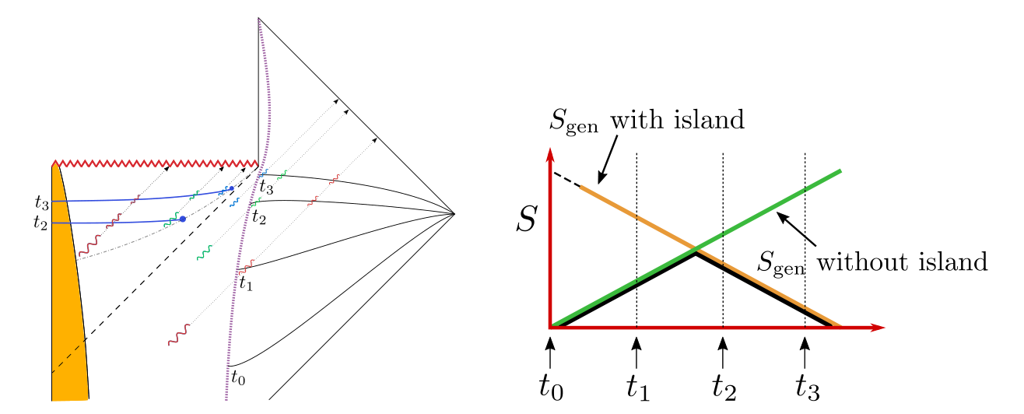
Background: Page Curve and Entanglement Wedge Reconstruction
Back to the Start: Page’s Argument, [D.Page,1993]
Unitarity of bipartite systems:
$$expS_{vn}≤min\{d_{A},d_{\overline{A}}\}$$
Split Property the Hilbert space:
$$H=H_{BH}⊗H_{Rad}$$
Phase Transition of Quantum Extremal surface： [G. Penington,2019; A. Almheiri, N. Engelhardt, D. Marolf and H. Maxﬁeld,2019]

Slide 4
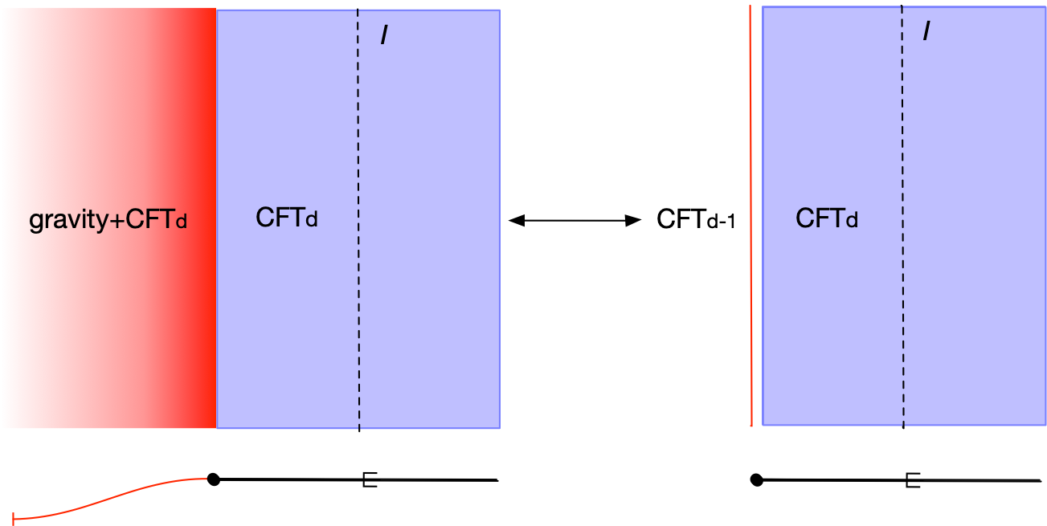
Background: Bath setup

Slide 5
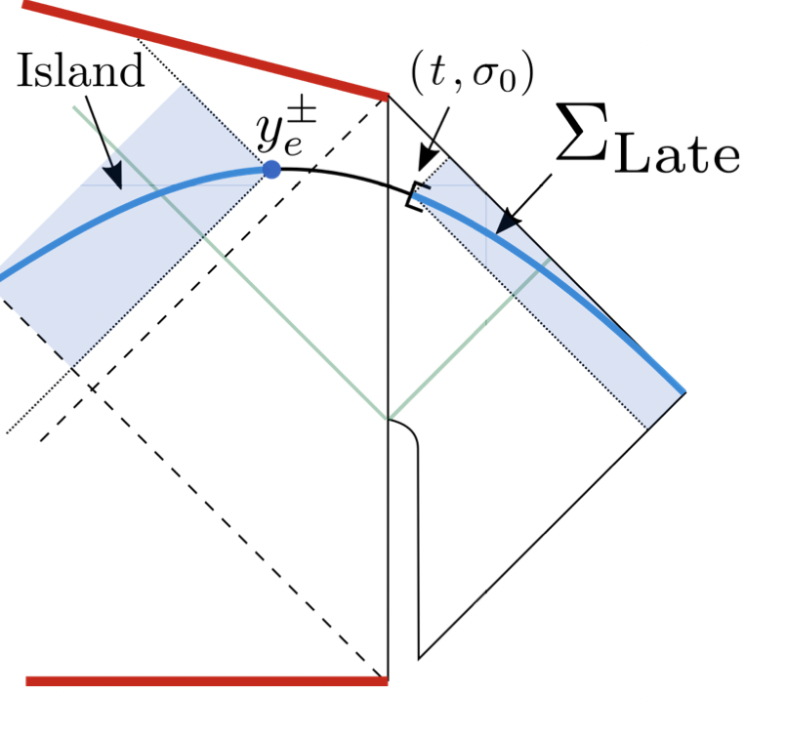
Background: island conjecture
Island Conjecture [A. Almheiri, R. Mahajan, J. Maldacena and Y. Zhao, 2019]
(double holography model based on RS brane)
At late times, we are required to include the disconnected region inside the black hole, which is often called “island” with full fine-grained entropy of the radiation is
$$S_{Rad}=\min_{X}\{{ext}_{X}[\frac{Area\left(X\right)}{4G_{N}}+S_{semi−cl}[Σ_{Rad}∪Σ_{Island}]]\}$$

Slide 6
Puzzles! All bath Puzzles!
Split Problem (H.Geng, Raju, etc)
Violating Gravitational Gauss Law
Massive Graviton
Dressing Problem of island
Trivial Page Curve vs Pivoted Page Curve
Trivial Page Curve

Slide 7
Questioning the bath setup
Split Problem of the non-gravitating bath setup:
holography is lack in the non-gravitational region
breaking the gravitational Gauss law so the energy conservation is not: $∂_{a}T^{ab}≠0,$
leading to massive graviton spectrum in dynamic gravity theory
otherwise: trivial Page curve for gravitating bath
[H.Geng, S.Raju, etc]
Trivial Page Curve

Slide 8
Historical Maxwell’s Demon: similarity to the non-gravitating bath
Central Spirit of the 2nd law thought experiment by Maxwell:
The demon can detect microscopic information and manipulate the evolving direction.
The ordinary tendency of subsystem is violated and the whole system could evolve into direction seems to be against the second law.
The demon’s hidden memory is always a part of the whole system for unitarity.
When including back the demon, 2nd law is not actually violated.
Proposal：

Slide 9
Reinterpret the Page Curve with Maxwell’s Demon
If we omit the hidden information of the demon, we find information loss with thermal entropy continue to increasing due to Hawking's calculation of radiation. This is a break of unitarity and leads to information loss.
If we regard the demon and information as outside of QG Hilbert space, we get the original Page curve, which is pivoted at the Page time. This could be what the non-gravitating bath means, with gravitational subsystem not unitary but the whole system unitary.
When adding back the un-notice Demon to the system, the holography get recovered together with a trivial Page Curve in the closed Quantum Gravity system: (Single boundary CFT dual)
New Question: Could the bath could also supply the possible tendency violation to the original gravitating system?
A:
B:
C: Trivial

Slide 10
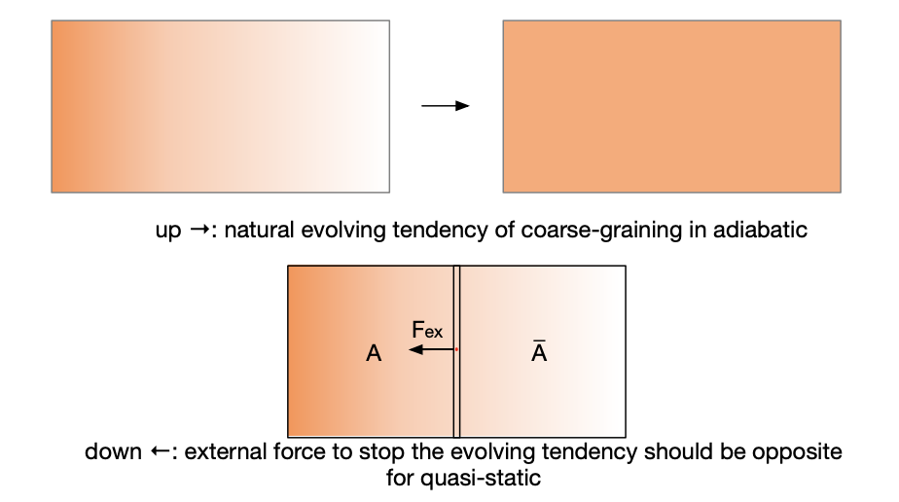
Distinguish the tendency
View of Onsager reciprocity relations for dissipating processes non-equilibrium
The density gradient/temperature gradient gives thermodynamic force, which can be stop by an external force

Slide 11
Entropic Gravity from Entanglement Entropy
The First Law of Entanglement Entropy:
Holographic Entanglement Entropy+Perturbation of Vacuum
Derive Einstein Equation
Derive Linear Einstein Equation
Local Iso-energy Process+Perturbation on Excited states:
Local gravitational force beyond Near-Horizon region emergent form external force
$$δS_{i}=δ⟨K_{i}⟩$$
$$dW_{g}=Td{⟨K_{0}-K_{1}⟩}_{1}$$
$$F_{μ}=T∇_{μ}{⟨K_{1}-K_{0}⟩}_{1}=-F_{g}$$

Slide 12
Entropic Tendency connection to EG
Verlinde’s Entropic Force Proposal: to unify coarse-graining tendency
Emergent gravity to generic situations
Varying Entanglement entropy in locally isoenergic processes: requirement of the external force
2. Emergent gravity beyond near-horizon region
3. New Holographic interpretation: varying the extremal surface
Y. An, P. Cheng, 2020
2nd Law direction: Entropic Tendency

Slide 13
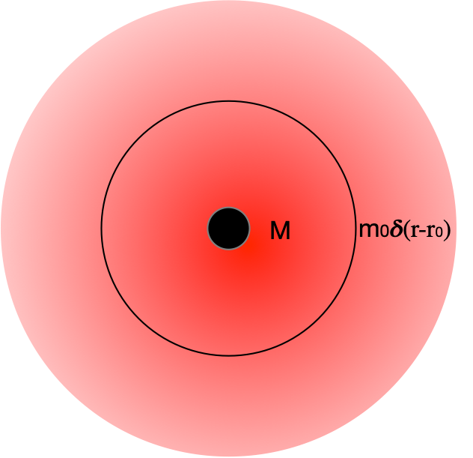
Entropic Mechanism for Gravitational Attraction
Thin shell attracted by black hole: Euclidean state with the equilibrating force
Requires External Force to cause Heat Flux
$$F_{ex}=T∇_{μ}S(M,m)$$
$$S(M,m_{0}e^{ϕ})=\frac{m_{0}e^{ϕ}}{T_{H}}=8πGMm_{0}e^{ϕ}$$

Slide 14
Condition for Emergent Gravity:
Late time:
What’s new:
Better Holographic interpretation of entropy associated with gravitational attraction
outer entropy
variation of Maximal mixed state
Universal to generic situations: such as to AdS black hole
Entropic Gravity is with the bath!
Tendency: Heat flux $δQ=TδS>0$ direction: Falling tendency
Emergent Gravity Applied to evaporation: $ΔS→δS_{vn}=δS(R)$
Detect Coarse graining direction from $δS_{vn}$ bound
$$S(M,m)≡\lim_{upper}Δ_{}S=δS_{\text{coarse}}=\frac{δA(μ_{a})}{4G}$$
$$δS_{\text{coarse}}(ρ)=\frac{δA(μ_{a})}{4G}$$
N. Engelhardt and A. C. Wall, 2017,2018
$$S_{gen}>0$$

Slide 15
Implication to Page curve: Maxwell’s demon in closed universe
Emergent Page curve of fine-grained entropy $δS_{vn}≠0$ requires the role of Bath/demon ➡️
Replace the bath role by the demon to open system
Equilibrating $F_{ex}$ from the bath: quasi-static evolution of Euclidean state
Tendency violation of original system
Effective gravity: cutout of UV
Non-variation of Extremal surfaces: Natural Tendency of trivial Page Curve

Slide 16
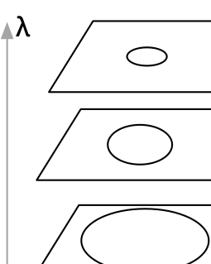
Summary:
Require $F_{ex}$: why evaporating black hole on each slice is Euclidean state.
Imitate absorbing boundary condition without break the holography
No massive graviton in such Euclidean Evolution!
Page Curve is also Emergent fine-graining
!Distinguishing potential Tendency violation of Page curve?
$$\frac{dE}{dt}=<:T_{uu}:>-<:T_{vv}:>$$
$$\frac{dE}{dλ}={H_{∂}}_{λ}-{H_{∂}}_{λ_{0}}$$
$$F_{ex}∝δ_{λ}S(R)≈δ_{λ}\frac{\text{Area}(Σ_{r_{s}})}{4G_{N}}<0$$
Future study
Soft hair vs Replica wormhole
Emergent Euclidean evolution with $F_{ex}$ ：1st Law for open gravitating systems
Emergent island in closed universe: demon in UV, emergent Split property
[P. Cheng, Y. An, 2020, 2023]

Slide 17
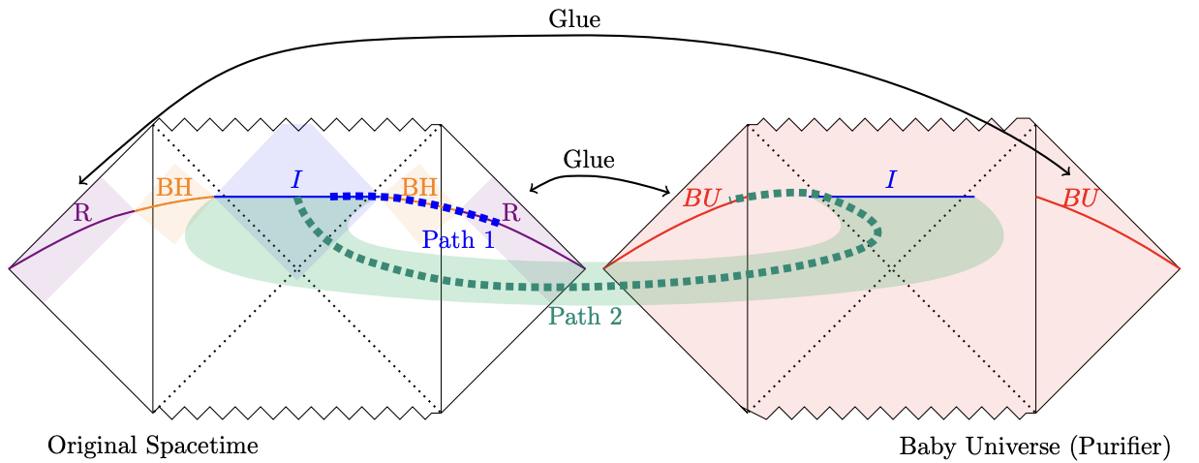
Possible Realization: Open
Example with baby universes：[N. Iizuka, A. Miyata and T. Ugajin, 2021]
Connecting to a Baby universe to maintain the gravitational Gauss Law by wormhole Path: Open System
Results:
Modified Gauss’s Law with baby universe
No Dressing Problem!

Slide 18
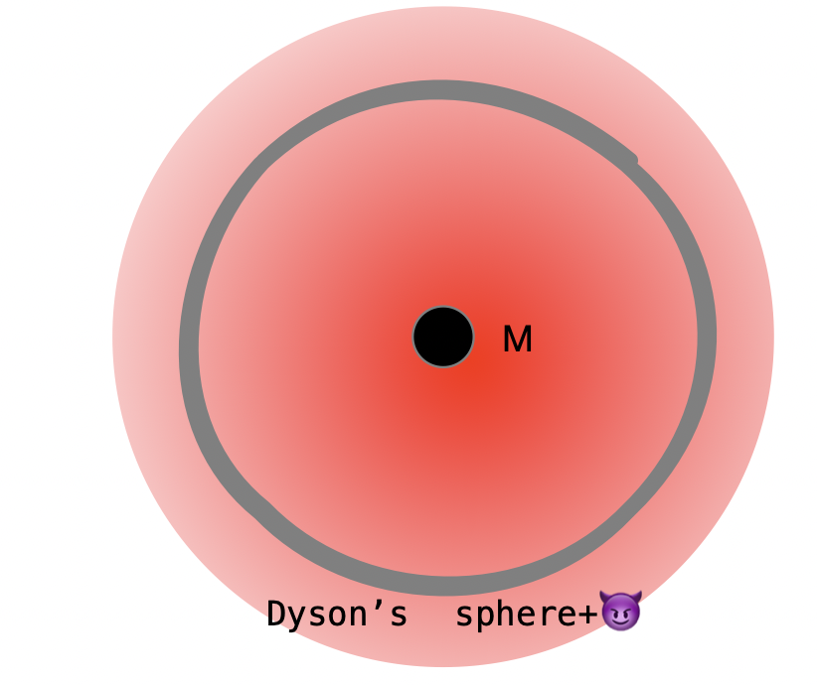
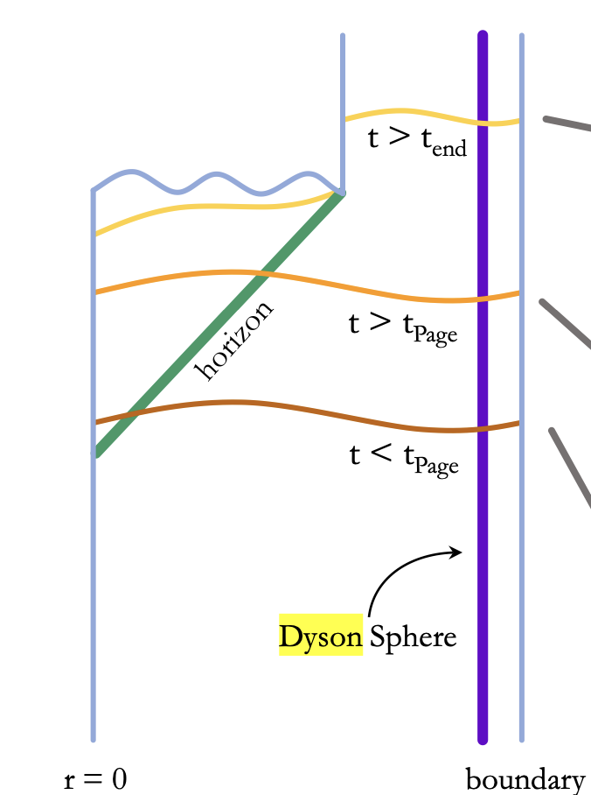
Possible Realization Dyson Sphere: closed
Still keeps the reflecting boundary condition:
$$T_{uu}|_{ϵ}=T_{vv}|_{ϵ}>0$$
Need 😈 for help?

Slide 19
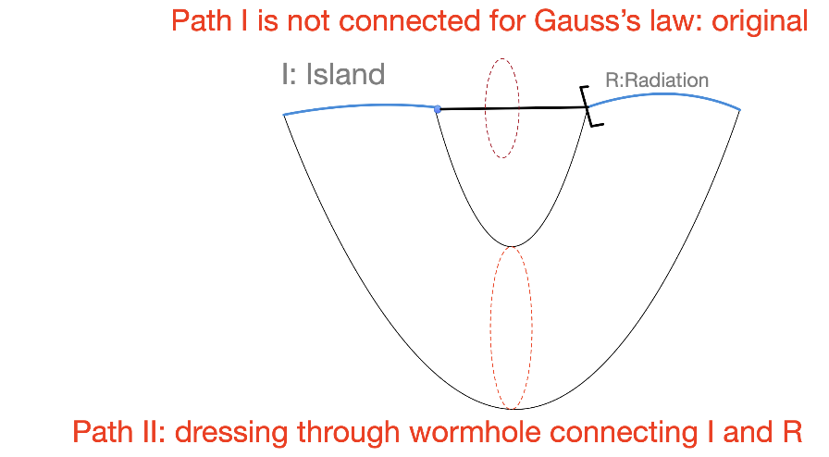
Dressing through wormhole:

