Slide 1
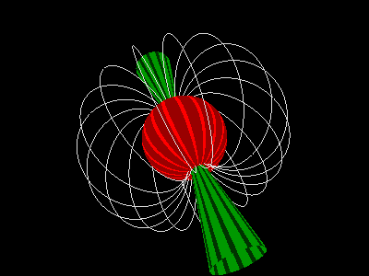
New Horizon of Gravitational Wave based on pulsar observations by FAST telescope
Chengmin Zhang
National Astronomical Observatories, CAS
University of Chinese Academy of Sciences--UCAS

Slide 2
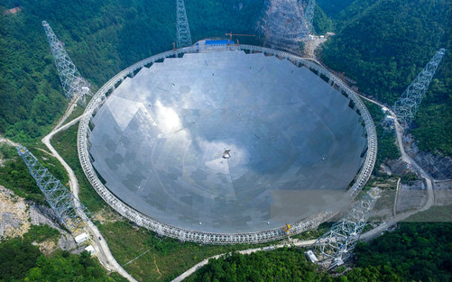
Out look of Talk
Fast is a Five hundred meter Aperture Spherical Radio Telescope, located in south China (Guizhou), the world's largest and most sensitive high-tech intelligent device; It will explore the deep universe into a new depth. This report describes the progress of FAST and pulsar observations, foresee the exploration of gravitational wave (GW) as well as the Einstein general relativity
1. FAST telescope： from construction to operation
2. Pulsar science： after 55-yr observations
3. FAST pulsar： black hole-pulsar , millisecond pulsar array
4. FAST operation： New horizon of gravitational wave

Slide 3
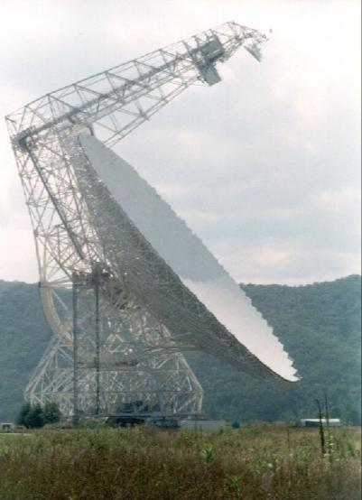
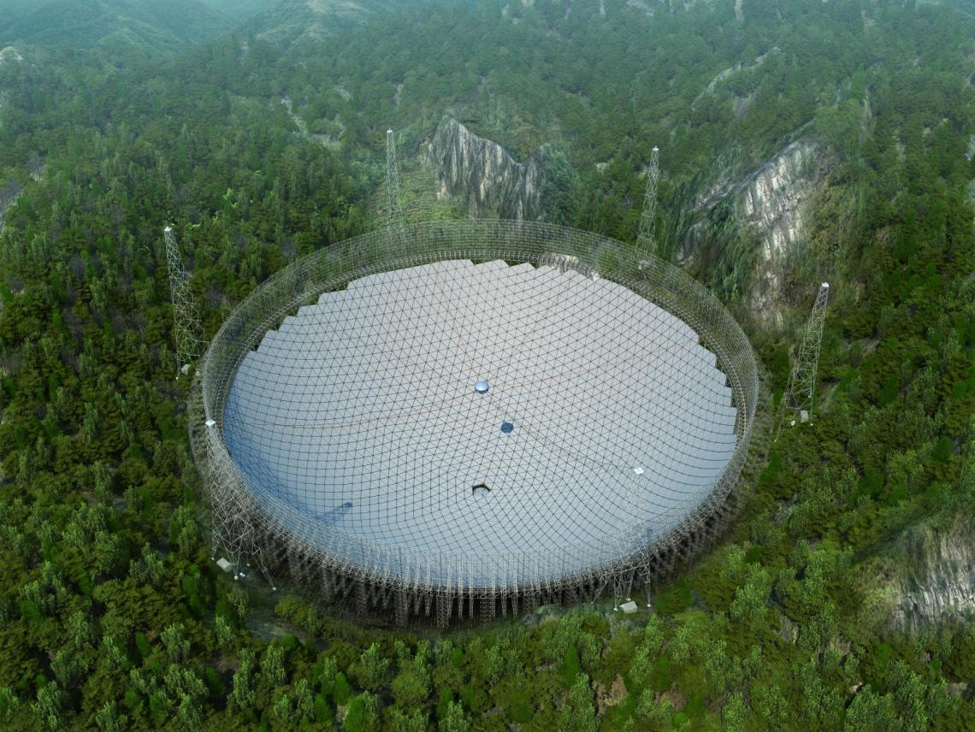
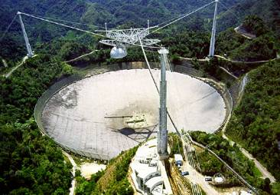
1. FAST (中国天眼) Introduction
Five-hundred-meter Aperture Spherical radio Telescope
Three renovative features：
1. Unique Karst geology； 2. Active reflector; 3. AI feedback receiving system
US GBT 100 m
Radio telescope
美国阿雷西博
Arecibo 305 m
US Arecibo 305 m
Aperture telescope
FAST：500 米口径球面射电望远镜
3
3
Notes:
3
3
五百米口径球面射电望远镜，aberration可以说为“像差”
4200面反射单元
Arecibo
强调自主创新

Slide 4
China FAST vs US Arecibo Telescope comparison as 500m:305m ?
Arecibo has a radar launch function, with a secondary reflection focusing; Both have the similar shape, topography, and geographic latitude.
Arecibo is one of the top 10 scientific projects in the United States in 20th century. Fast: Arecibo Lighting Aperture Comparison 300M: 200m = 1.5, Fast is 2-3 times more sensitive

Slide 5
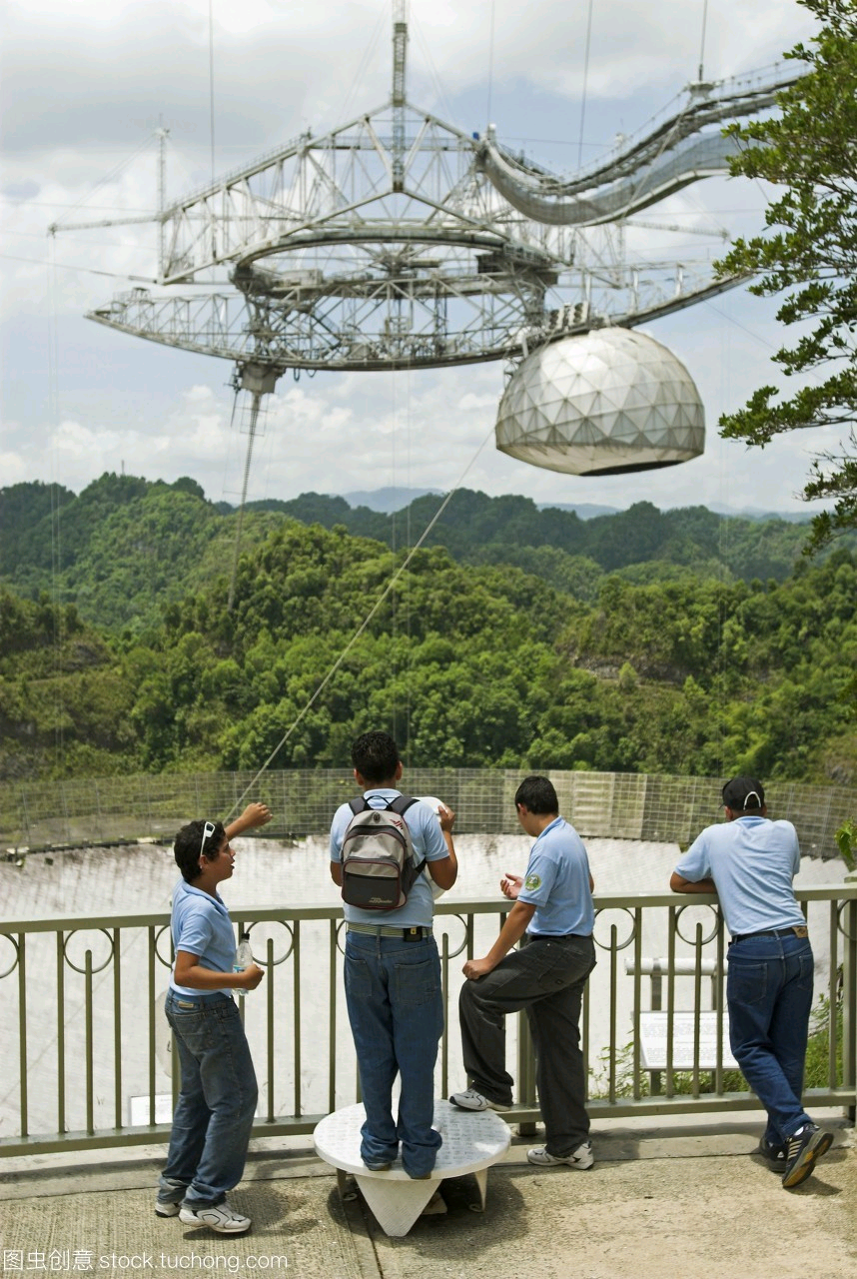
FAST-Arecibo： Arecibo 305 meters diameter radio telescope was accidently collapsed, once the symbol of the American Dream that created lots of world first! On December 1, 2020, all three supporting towers of Arecibo suddenly broke, and the 900-ton receiver platform fell directly onto the telescope's reflecting panel, damaging the antenna and completely destroying the electronic equipment, the world was in an uproar; However, what are the questions and revelations?

Slide 6
Time line of FAST project 1994---2023
2016年9月 FAST 落成，贵州黔南
1994，Project proposed
1998，Initial model
2006， International
review passed
2007， NDRC sets up
project
2011， Construction started
2016， main completion
2020， state acceptance
国家验收
2023， discover >700
new pulsars
2020年1月 FAST正式 验收，
造价11.5亿元
FAST脉冲星探测700多颗
NDRC=national development& reform committee 国家发改委

Slide 7
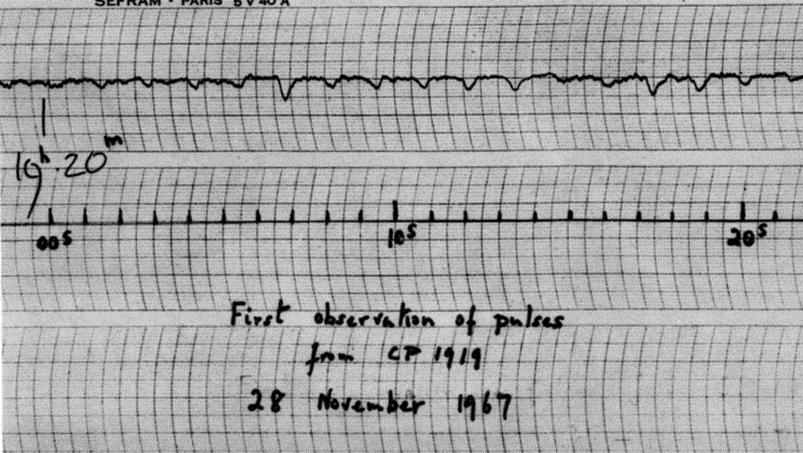
2. Pulsar sciences：脉冲星科学 pulsar is one of the most important astronomical discoveries of the twentieth century
1967， Jocelyn Bell, a PhD student at the University of Cambridge, discovered a series of strange pulses of radio signals, with a period of 1.33 seconds, later identified as pulsars (rotating neutron stars) .
Jocelyn Bell, “Mother of pulsars”, knighted by Queen Elizabeth, former president of the Royal Society of Physics and astronomy, president of the Royal Edinburgh Society, Physics Breakthrough Award 2018.
The discovery of Pulsars won the Nobel Prize twice: in 1974 and 1993, though she was denied the Nobel Prize, well it is the true No-bell Prize。

Slide 8
脉冲星？如何形成？ How to form a pulsar ？ On July 4, 1054， astronomers in Song Dynasty recorded the Taurus “Tianguan Star” event, a rare world-class historical event in which a supernova exploded at the center of its remnant, leave behind a pulsar (rotating neutron star)， with period of 33 milliseconds.
In 1968 , Arecibo searched SNR1054-supernova remnant, discovered the Crab Pulsar, with a rotation period of 33 milliseconds. It is the only known accurate age and multi-band calibrated pulsar.

Slide 9
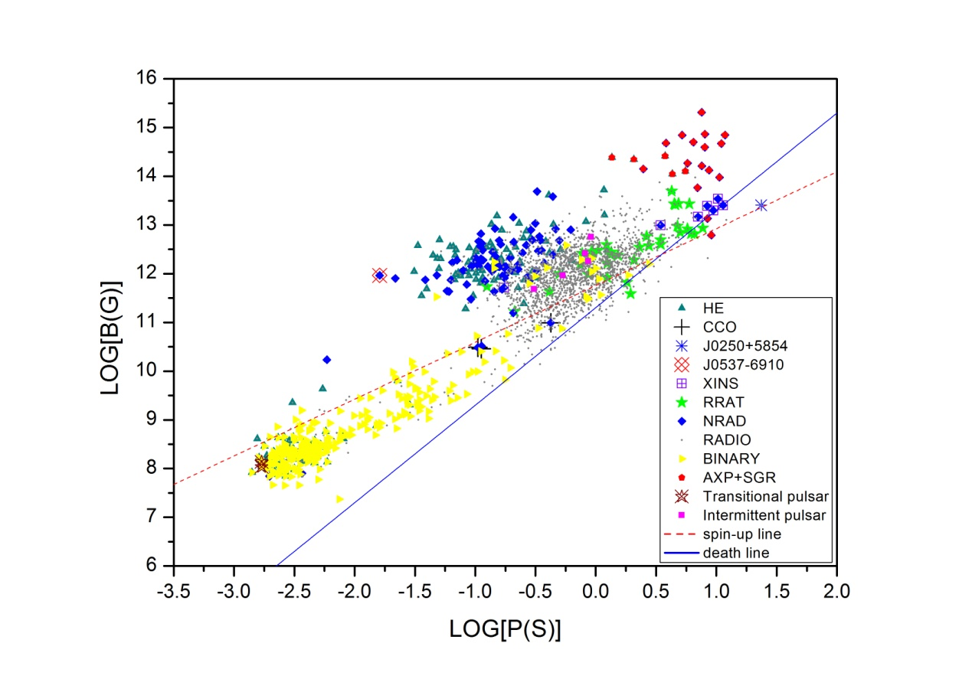
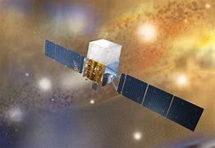
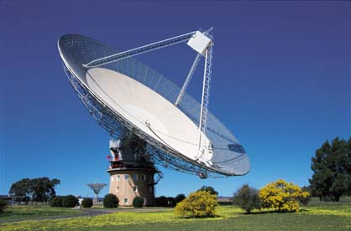
Pulsar observations for 55 years: number > 4,000
Pulsar detection methods are diverse: From ground telescope to space satellite, multi-energy, multi-band, including Gamma Rays, X-rays, optics, radio; Pulsar researches go into multi-messenger era: electromagnetic, gravitational waves, neutrinos, cosmic rays
Pulsar magnetic field vs spin period diagram
Jocelyn Bell was interviewed by China president Xi Jinping in 2012

Slide 10
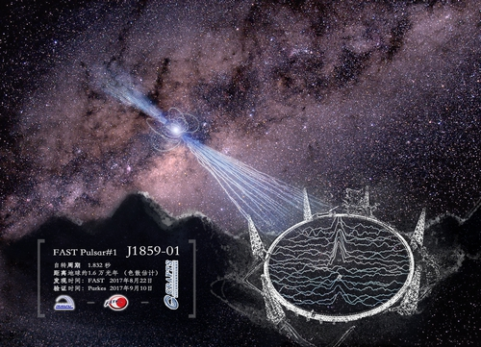
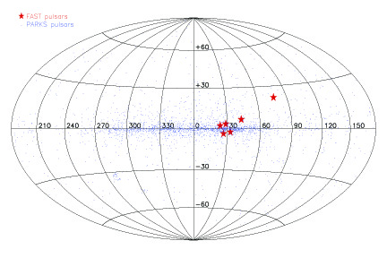
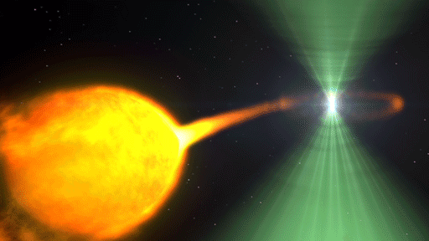
FAST Survey finds new pulsars over 700
important targets:
pulsar-black hole binary, sub-millisecond pulsar
The P=23.5 s long-period pulsar
was observed at high latitudes
The first pulsar discovered by FAST, PSR J1859-0131, took 23 seconds to process the data (for pulsar confirmation, it took Arecibo 59 seconds and Parkes 2,300 seconds)

Slide 11
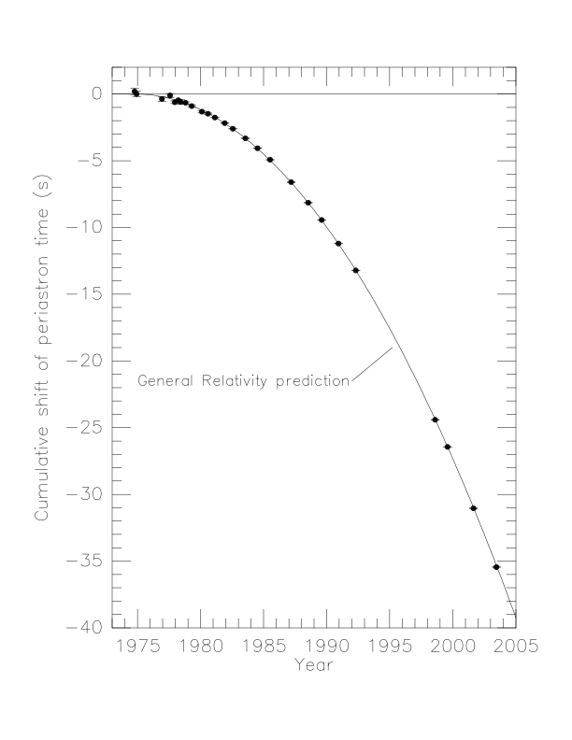
3. FAST pulsar and gravitational wave
1974, Arecibo discovered the first pulsar binary, PSRJ1913+16, indirectly confirming the gravitational wave; 2003, Parkes discovered double pulsar systems; 2006, the GBT radio telescope again verified GW with high accuracy. So far, astronomers have found 25 pairs of double neutron star systems, four DNSs tested GW. FAST found a two-neutron star DNS system
DNS orbit shrink 2cm/day，
GW~ 0.1% accuracy confirmed

Slide 12
Gravitational wave spectra: sources and detectors

Slide 13
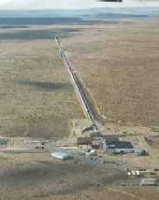
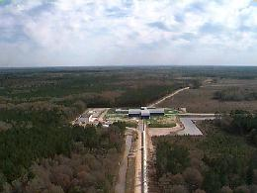
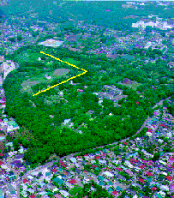
Global Gravitational Wave Detectors
LIGO (USA)
Hanford, WA and Livingston, LA
Kagra (Japan)
VIRGO (French-Italian)
Cascina, Italy

Slide 14
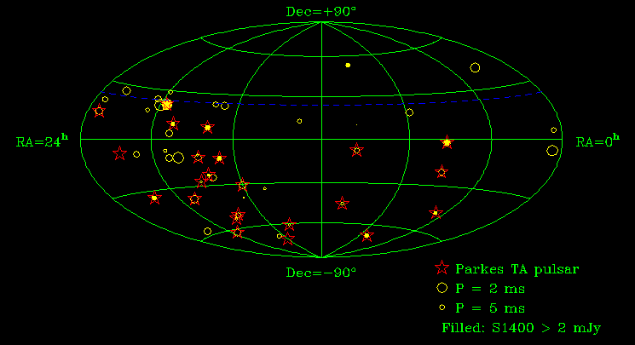
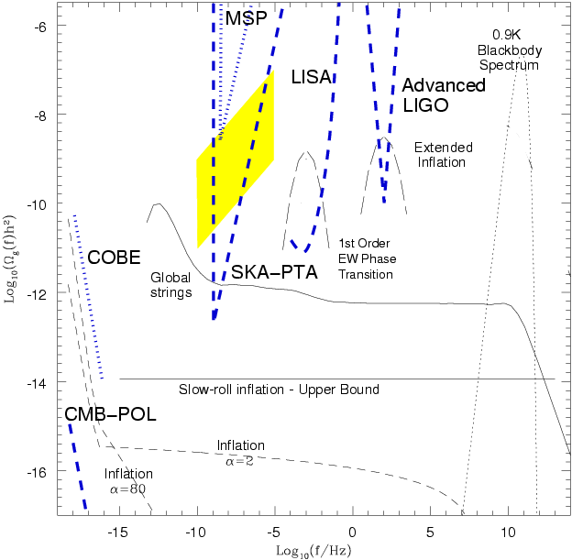
Low frequency GW: Millisecond Pulsar Array
毫秒脉冲星计时阵列
50 - 100 MSPs，period P < 10 ms；测时precision Nano－second，
到达时间TOA计时精度； Parkes＋Arecibo： FAST： sensitivity！

Slide 15
1. Parkes Pulsar Timing Array-- PPTA 澳大利亚帕克斯脉冲星计时阵列 2. NanoGrav North American NanoHertz GW Obs 美国脉冲星阵列引力波探测 3. The European Pulsar Timing Array (EPTA) 欧洲脉冲星阵列引力波探测 4. China pulsar array for GW 中国脉冲星阵列引力波探测
FAST pulsar and GW in the future

Slide 16
A letter from China president Xi Jinping to FAST team
道路自信、理论自信, 制度自信、文化自信
Road self-confidence, theory self-confidence,
system self-confidence, culture self-confidence
President XI pointed out that, the Five hundred meter Aperture Spherical Telescope is known as the “Chinese Heaven Eye”, the world's largest single-aperture and most sensitive radio telescope. It is of great significance for our country to achieve a major breakthrough in the scientific frontier and accelerate innovation-driven development. We will strive to make new and greater contributions to building an innovative country and a powerful country in science and Technology.

Slide 17
4. FAST operation： New horizon of gravitational wave
1. New pulsars N> 2000
2. BH-pulsar, short orbit- DNS？
3. More MSPs, now >500, GW？
各国领导人、各级领导现场指导， 超过千万人次参观FAST

Slide 18
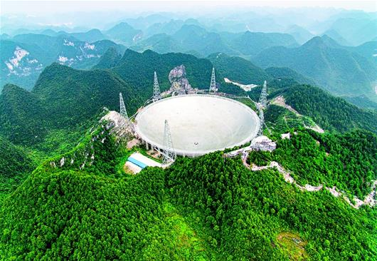
Thanks very much

Slide 20
南仁东之问：外星人是人吗 ？
霍金的警告：中国天眼不要寻找外星人
人类是地球环境的产物

Slide 21
报告人简介：
张承民，中国科学院国家天文台研究员， 中国科学院大学岗位教授，博士生导师，曾担任中国天眼FAST工程前首席科学家南仁东的科学助理并学术秘书。在大连理工大学获学士与硕士学位、香港大学博士学位。科学经历包括，澳大利亚悉尼大学、中国台湾新竹国立清华大学、巴西圣保罗州立大学进行博士后研究，在天津河北工业大学从事教学与科研；以及海外多所大学和科学机构从事客座研究，如澳大利亚国立大学、德国波茨坦大学和德国马普爱因斯坦引力研究所等。研究领域涵盖天文学天体物理，脉冲星中子星、相对论引力理论、引力波辐射、射电闪烁；已发表学术论文60余篇，出版科研与科普书籍多本：《神奇的太空失重》（斯普林格出版社），《中子星与脉冲星天体物理》（中国科学出版社），《中国天眼：神秘的脉冲星》（清华大学出版社）， 《奇妙的太空探秘，随神州进入太空课堂》（北京师范大学出版社），并主编国际会议文集《白矮星中子星黑洞多尺度吸积》（剑桥大学出版社）。

Slide 22
报告简介：
中国天眼（FAST）是500米口径球面射电望远镜、我国自主建设的国家重器，世界最大的高科技智能机器，它将宇宙的视野推向新的深度；FAST工程成功的意义在于，它建构了国家科技崛起的模板，建立国家科学自信与文化自信，昭示大科学工程与社会发展融合的全新路径。报告探讨诸多科技热点话题，我国为什么独立自主地建设FAST，为何选择去贵州深山？ FAST高科技要素涉及光机电、大数据、人工智能、大型装置，它如何嵌入我国社会经济与基础设施发展的战略需求？人民科学家南仁东为何仰天长啸，“生为天眼、死得其所”？ 国家崛起是FAST的初心与使命，从百年梦想到百年变局， 二十大报告开启了中国新时代的科技长征。 报告内容包括：
1. FAST的概况： 台址建设与中国制造、为何选择贵州深山？
2. FAST高科技： 光机电、大数据、人工智能、大型装置
3. FAST的意义： 社会经济，基础设施，绿色环保，建筑地标
4. FAST创始人： 人民科学家南仁东，“生为天眼、死得其所”
5. FAST的初心： 国家崛起，百年梦想，新时代的科技长征

Slide 23
3. 中国天眼FAST的建设意义？
1）科学探索：宇宙奥秘、仰望星空、天文学
2）技术提升：光机电、大数据、人工智能
3）工程建设：大装置、大型结构、中国制造
4）社会发展：老少边穷、教育、科技、精准扶贫
5）区域经济：基础设施、道路交通、旅游经济

Slide 24
3. FAST建设意义：贵州社会效益
科技: 光机电、自动化、大数据等新产业
教育：大学教育与联合培训
社会：天文学科普，全球视角、文化进步
基建： 世界最高、最大、最长桥梁
经济：20年对比，高铁、机场、高速、GDP百亿
旅游：红色、绿色、蓝色：天眼星空
行政：中央地方、跨部门、跨学科、跨地区
贵州：一带一路新亮点，辐射东南亚新坐标

Slide 25
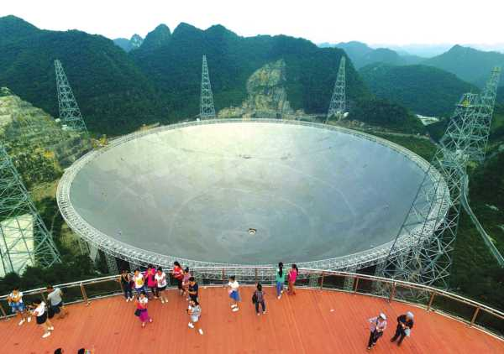
FAST建设的能源考虑，煤水电每天运行费用电费十万元
中国天眼的意义：科技旅游，节能、绿色、环保
节能：三十吨馈源，面板打孔减重
绿色: 植物恢复，原生态保护
野生动物： 猴子，鸟类，蜜蜂
环保： 周围防护区5km

